Slide 1

Embedded Systems & iot Project
Project : Home Automation System
-By
Name : Anand Kumar
Reg No. - 23163135006
College : Government Engineering college,
Vaishali – 844115

Slide 2

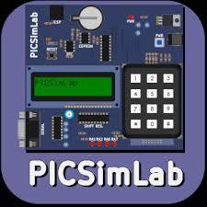

PROJECT REQUIRMENTS
Goal : Home Automation System.
Microcontroller Used : ATMEGA328p
Software Used :
1. Arduino IDE
2. PICSIMLAB
3. Blynk console

Slide 3
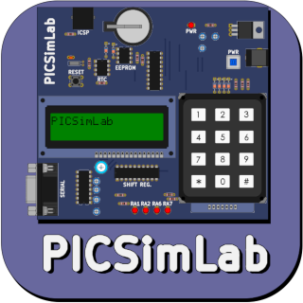
Project requirements
PICSIMLab
PICSIMLab is a proprietary free software for simulation of various microcontroller boards available
It can simulate most of the widely used microcontroller boards like PIC, Arduino, STM32, ESP32, etc.

Slide 4
Project requirements
Blynk Console :
Blynk Console is a cloud-based platform that connects your hardware (Arduino + W5500) with a mobile app interface.
It enables remote monitoring and control of appliances through the internet.

Slide 5
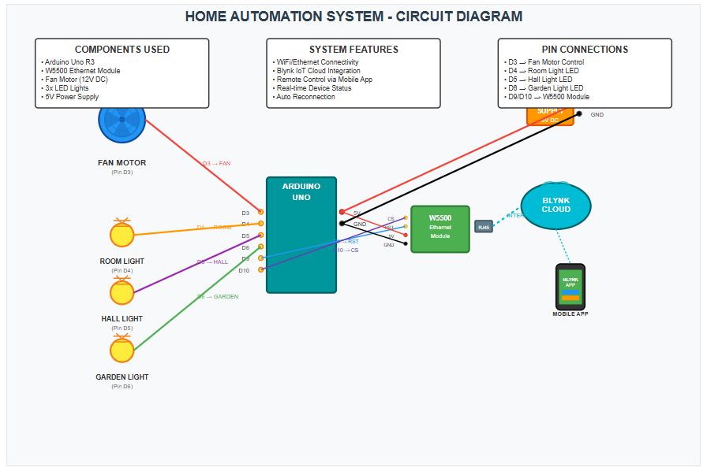
Block diagram

Slide 6
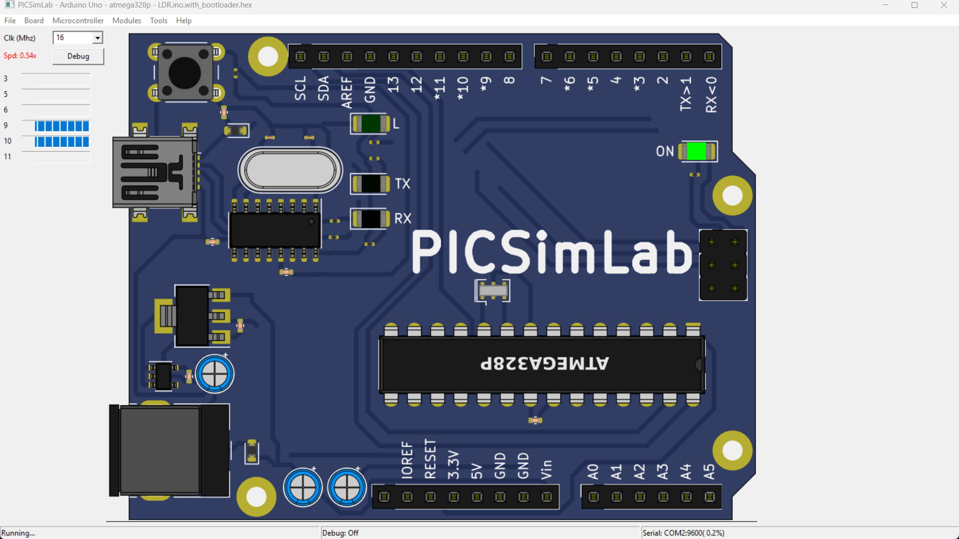
Component used
Arduino IDE:
Written and uploaded the program controlling:
3 LEDs (Room, Hall, Garden Light)
1 Fan
16x2 LCD Display
W5500 Ethernet communication
Used external libraries like
#include <SPI.h>
#include <Ethernet.h>
#include <BlynkSimpleEthernet.h>

Slide 7
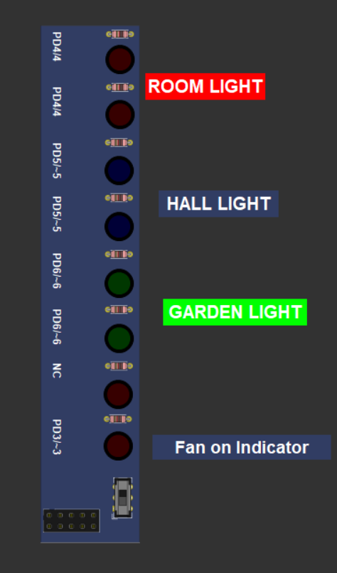
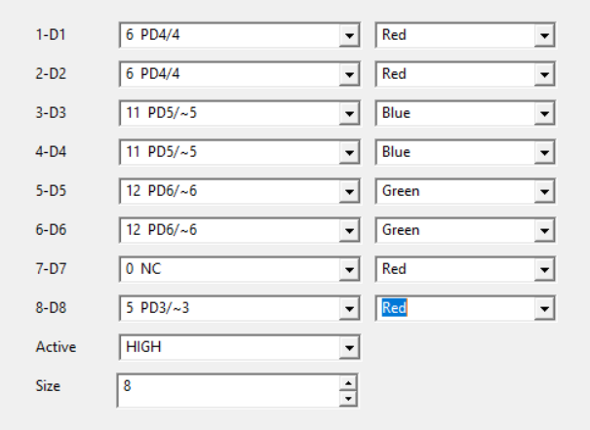
Component used
Led Module:
Room Light (Led 1 & 2 )
Hall Light (Led 3 & 4 )
Garden Light (Led 5 & 6 )
Fan on Indicator (Led 8)

Slide 8
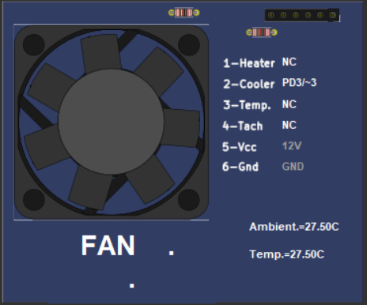
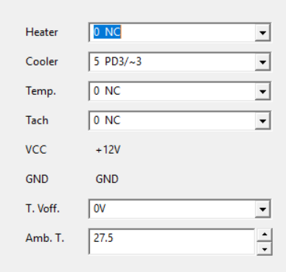
Components used
FAN :
Simulates a cooling device like a fan or cooler.
When you press the fan button in the Blynk app, a signal is sent to the Arduino through the W5500 Ethernet module.

Slide 9
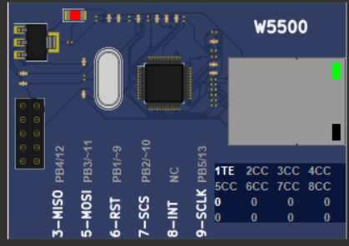
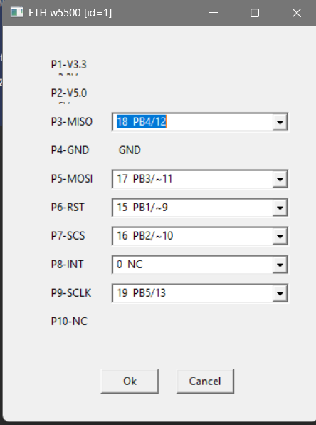
Components used
W5500 Ethernet Module
A high-performance Ethernet controller based on the WIZnet W5500 chip.
Enables the Arduino UNO to connect to the internet via LAN cable.
Communicates with the Blynk cloud platform for real-time control.

Slide 10
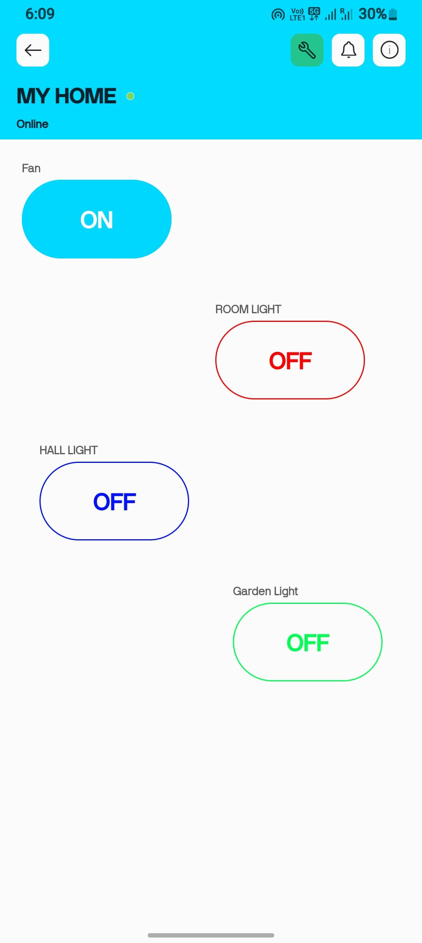
Blynk console
Mobile Dashboard Setup:
Drag 4 Button Widgets
Assign:
Button 1 → V1
Button 2 → V2
Button 3 → V3
Button 4 → V4
Set Mode: Switch

Slide 11
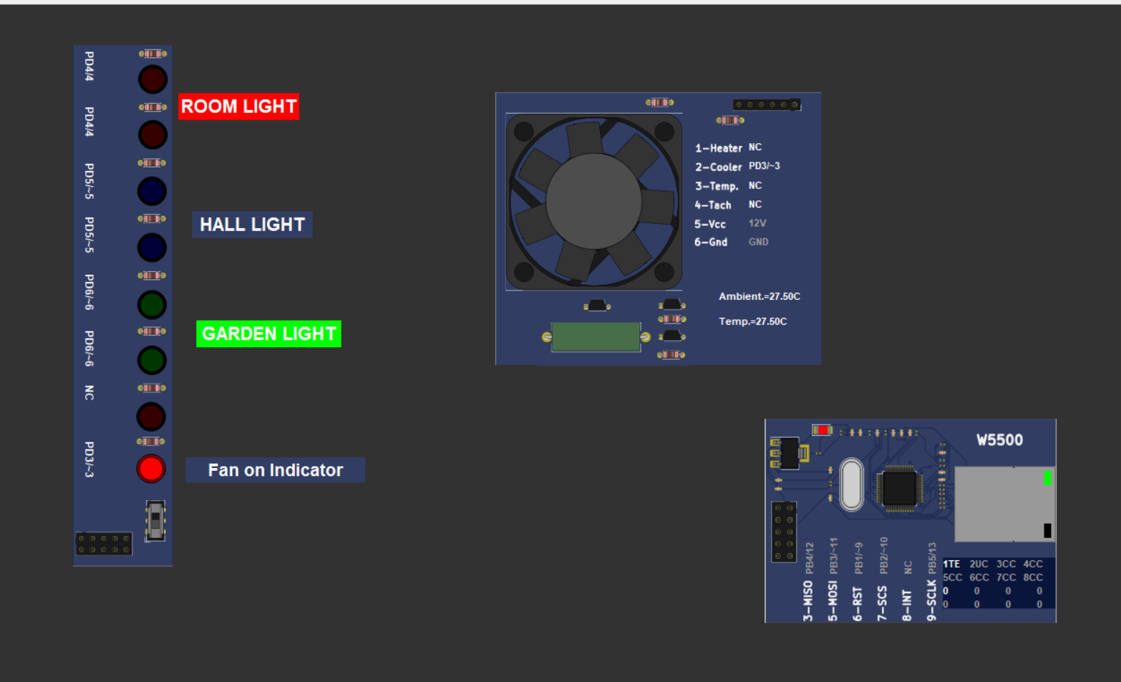
Fan :
When I turn on the fan switch, the fan indicator on the fan starts.

Slide 12
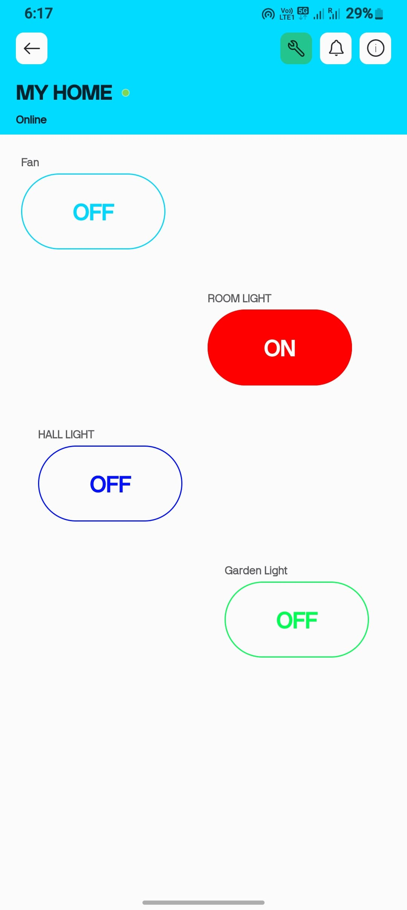
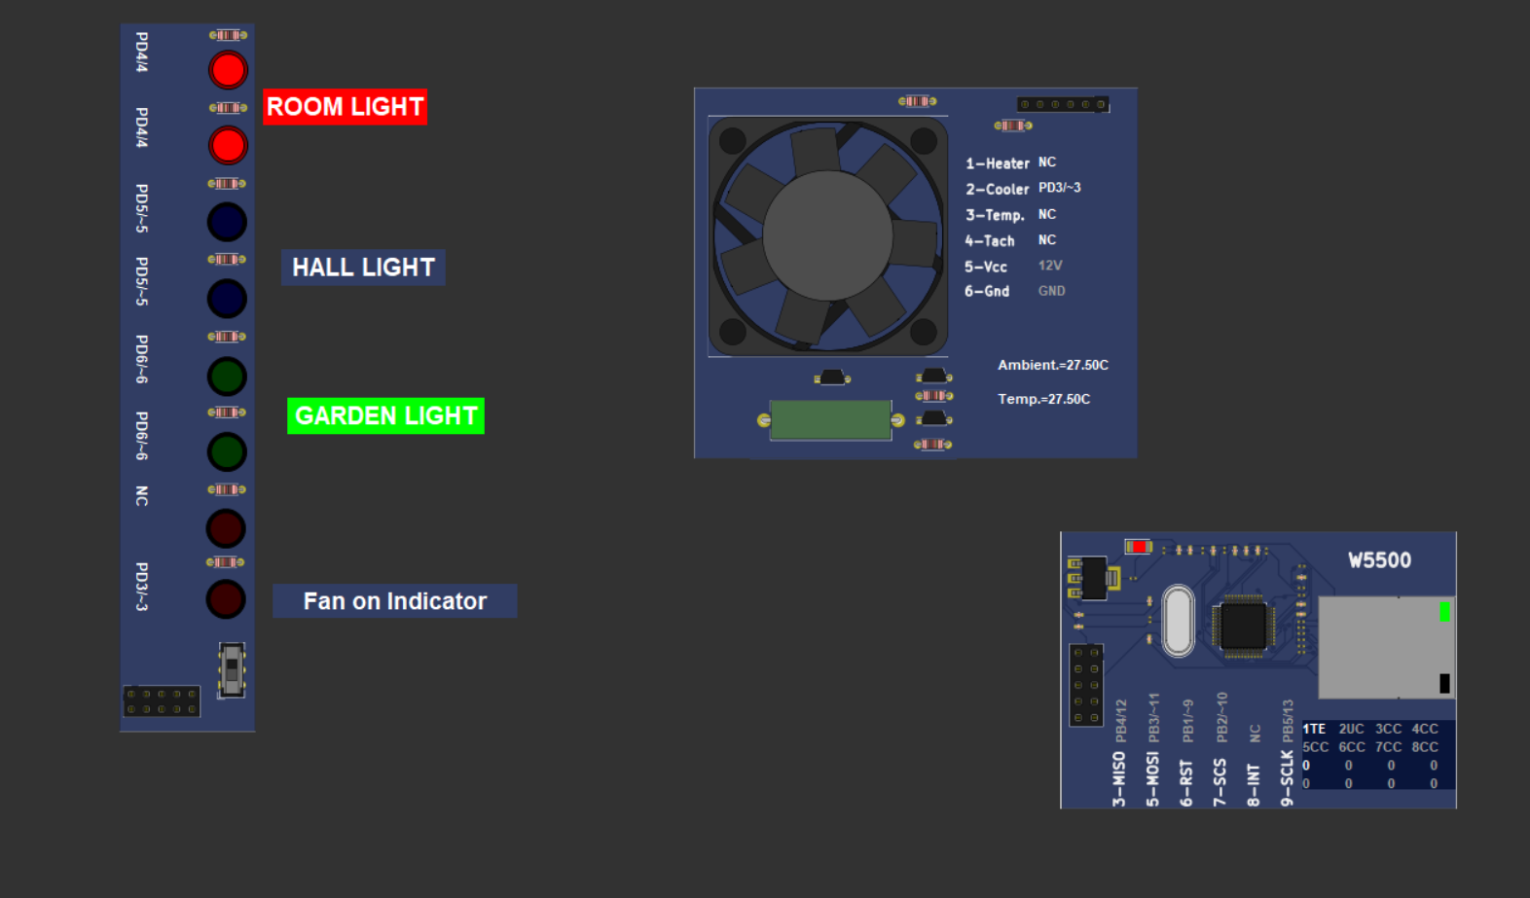
Room Light :
When I turn on the Room switch, the Led 1 & 2 (Red) Start Glowing

Slide 13
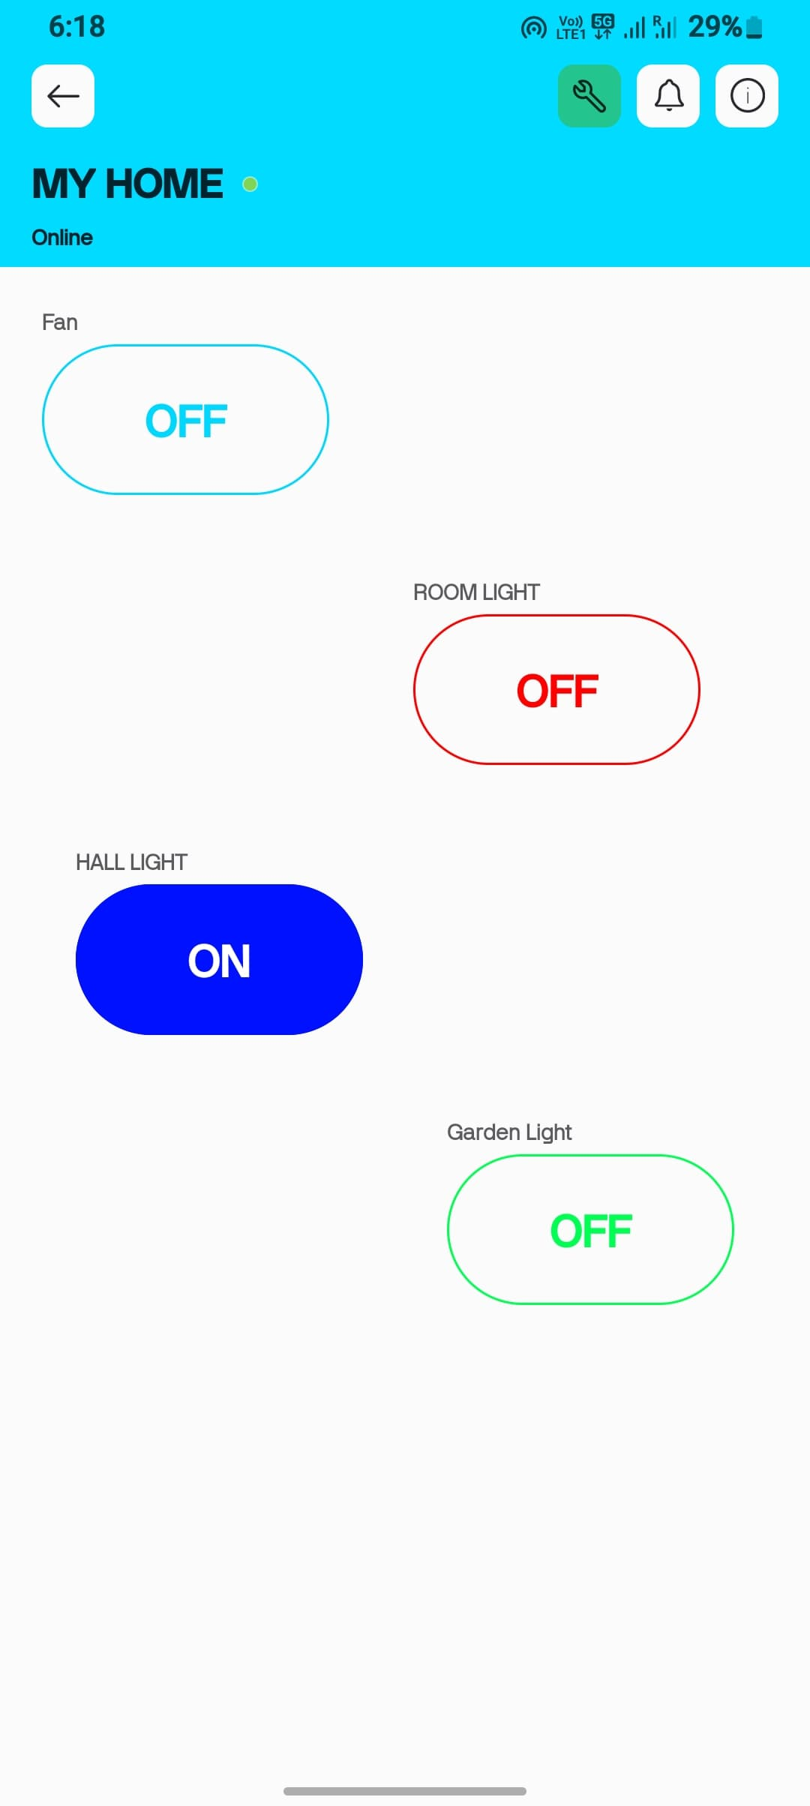

Hall Light :
When I turn on the Hall Light switch, the Led 3 & 4 (Blue) Start Glowing

Slide 14
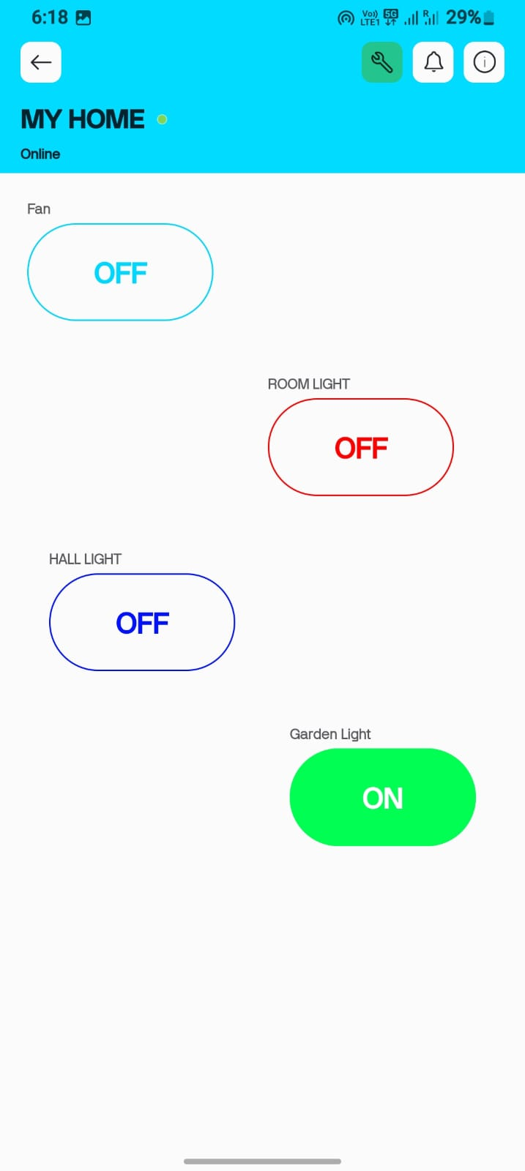
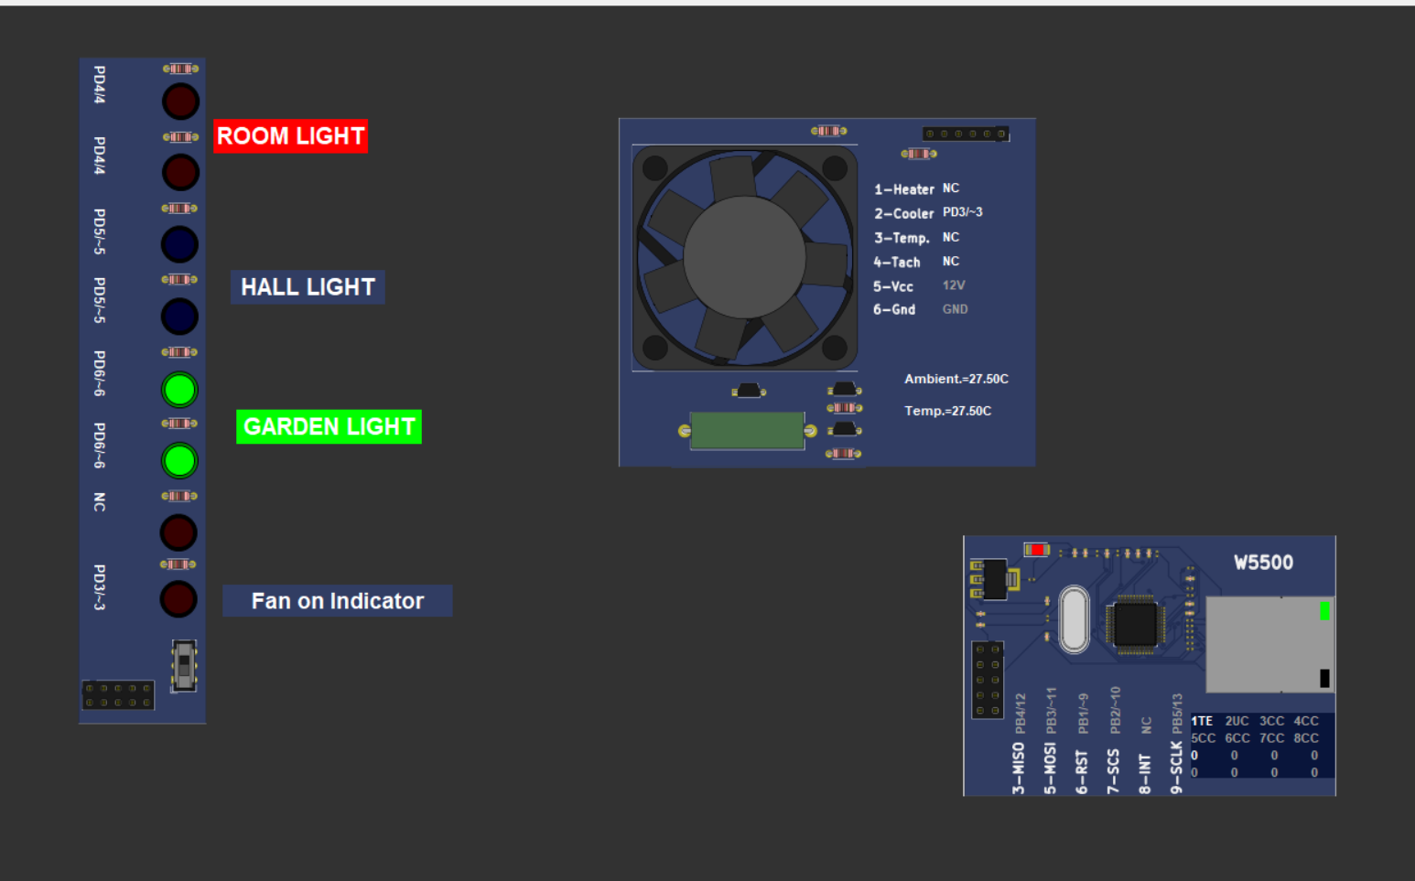
Garden Light
When I turn on the garden light switch, the Led 5 & 6 (Green) Start Glowing

Slide 15
Thank you

